Slide 1
Sudoku Solvers
Team:
Michael Richards
Jaden Krekow
Alice Luce
Adrian Rodriguez
Faculty:
Raghuveer Mohan

Slide 2
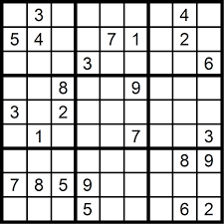
What we seek to accomplish
Create a sudoku app that allows for the user to:
Generate random sudoku puzzles based on requested difficulty
Try and solve that sudoku puzzle (1 unique solution)
Give user option to auto solve the puzzle or give hints
Support different variations of sudoku

Slide 3
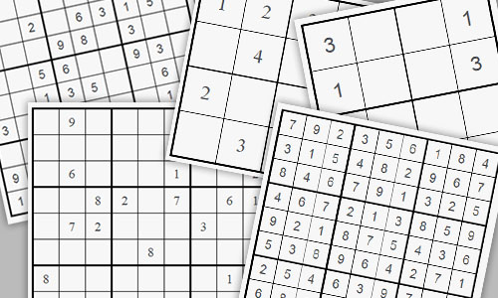
How we can accomplish that: Puzzle Generation
Conduct literature review to find out what type of algorithm is most efficient for sudoku generation
Construct algorithm based off the finding which ensures the puzzle:
Has a solution
Has 1 unique solution
Matches the difficulty set by user

Slide 4
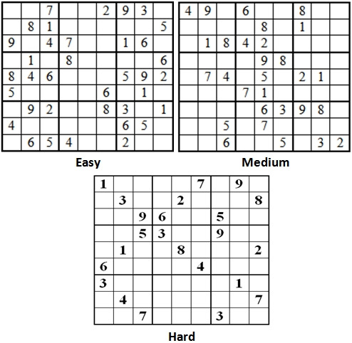
How we can accomplish that: Difficulty Settings
Difficulty in sudoku revolves around information
The more information given (filled in cells), the easier it is to solve
The less information, the harder it is to solve
Puzzle generator will have a set cut off for how much information to give based on the selected difficulty

Slide 5
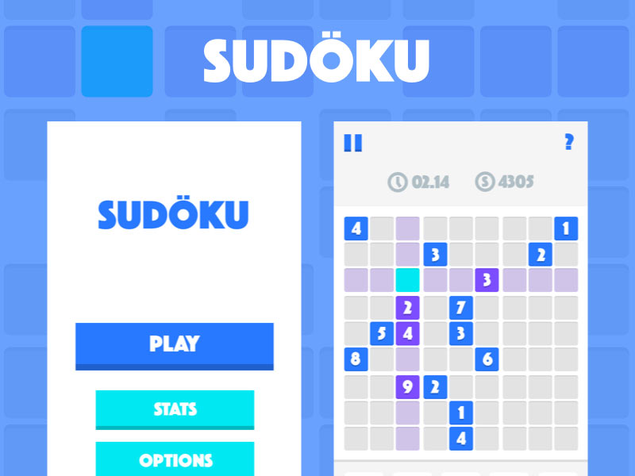
How we can accomplish that: User Interface
Play and solve sudoku puzzles with use of an effective user interface
PyQt as our framework (subject to change)
Streamline the solving process by traversing the cells via arrow keys
Play test and incorporate feedback

Slide 6
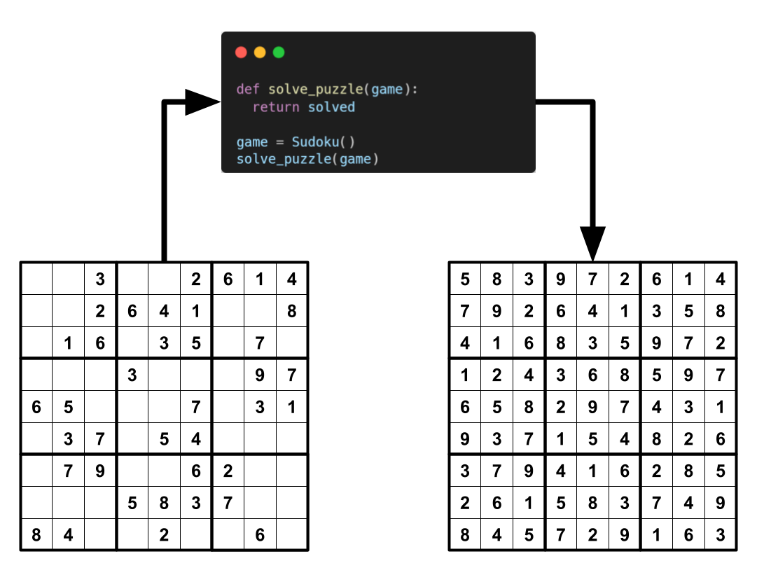
How we can accomplish that: Sudoku Solver
Conduct literature review to see what type of algorithm or AI model is most efficient
Keep time complexity to a minimum
Include functionality to solve sudoku variants
Use fast code and optimized APIs to reduce overhead
Design data structures to reflect variants and their differences while keeping complexity low

Slide 7
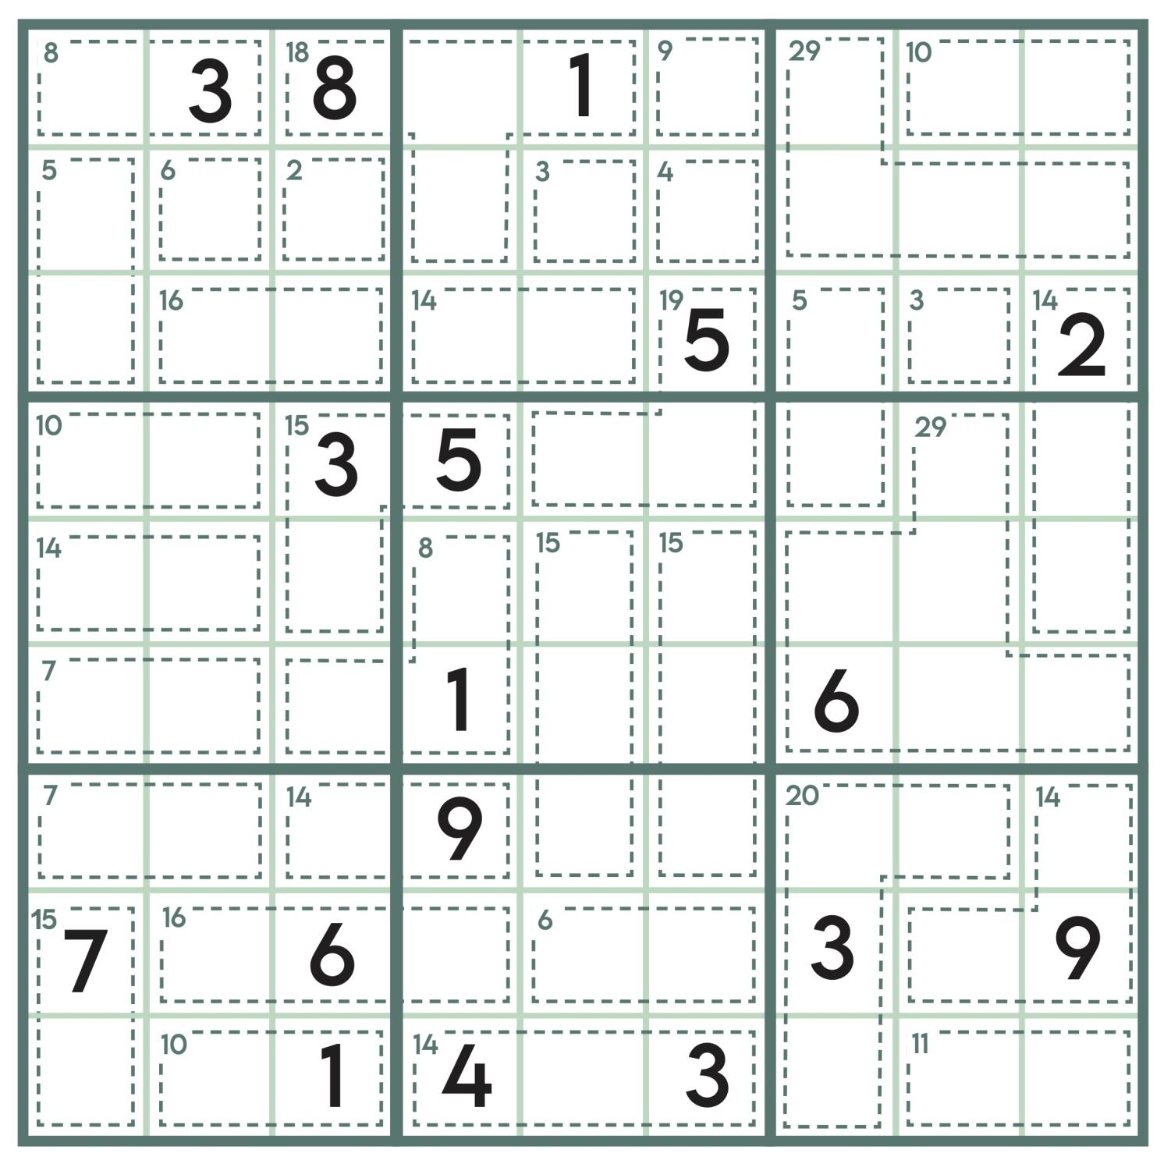
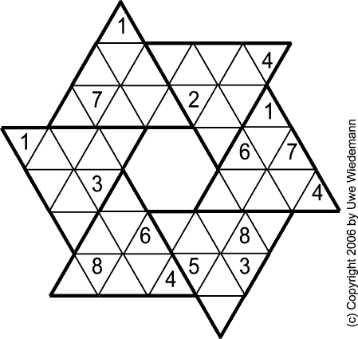
How we can accomplish that: Sudoku Variations
Some sudoku variations can be adapted to use the same generation algorithm, while some can not
Pick which variations to include, figure out if they can be adapted to current generator algorithm
Write unique algorithm if necessary

Slide 8
Questions?

